Slide 1

Software Design (swD392)
Ch07 – Static Modeling

Slide 2
Main Contents
Overview
Association Between Classes
Composition & Aggregation Hierarchies
Generalization/Specialization Hierarchy
Static Modeling & the UML
Context Modeling
Static Modeling of Entity Classes

Slide 3
Overview
﻿The static model
﻿Addresses the static structural view of a problem, which does not vary with time
﻿Describes the static structure of the system being modeled, which is considered less likely to change than the functions of the system
﻿Defines the classes in the system, the attributes of the classes, the relationships between classes, and the operations of each class
﻿Static modeling refers to the modeling process and the UML class diagram notation is used to depict the static model

Slide 4
Overview Objects and Classes
Objects represent ‘’thing’’ in real world
Provide understanding of real world
Form basis for a computer solution
An Object (object instance) is a single ‘’thing’’
E.g., an account, an employee
A Class (object class) is a collection of objects with the same characteristics
E.g., account, employee
Attribute
Data value held by objects in class
E.g., account number, balance

Slide 5
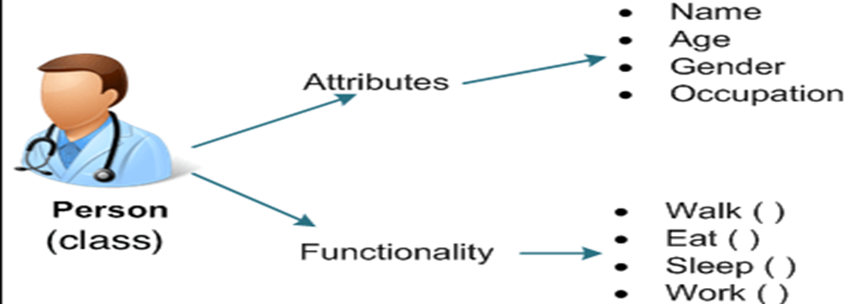
Overview Objects and Classes

Slide 6
Overview Static Modeling
Define structural relationships between classes
Depict classes and their relationships on class diagram
Relationships between classes
Associations
Composition / Aggregation
Generalization / Specialization
Static Modeling during Analysis
System Context Class Diagram: depict external classes and system boundary
Static Modeling of Entity classes: persistent classes that store data
Notes:
Persistent: cố hữu, kiên trì

Slide 7
Association Between Classes
﻿An association defines a relationship between two or more classes, denoting a static, structural relationship between classes.
I.e: Employee Works in Department, where Employee and Department are classes and Works in is an association.
The classes are nouns, whereas the association is usually a verb or verb phrase.
﻿A link is a connection between instances of the classes (objects) and represents an instance of an association between classes
﻿I.e: Jane Works in Manufacturing,
Jane is an instance of Employee and Manufacturing is an instance of Department.
A link can exist between two objects if, and only if, there is an association between their corresponding classes.
Notes:
Persistent: cố hữu, kiên trì

Slide 8
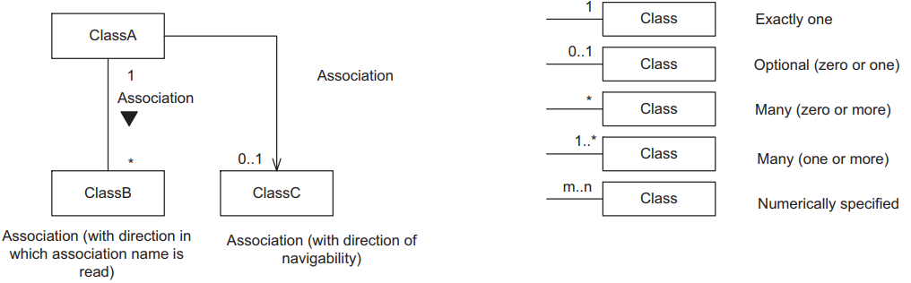
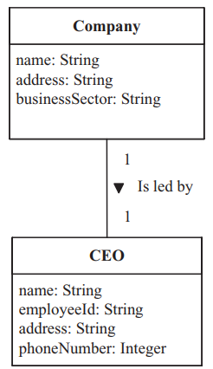
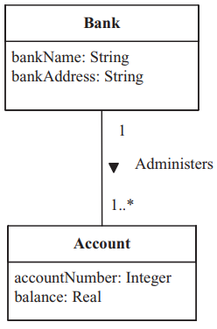
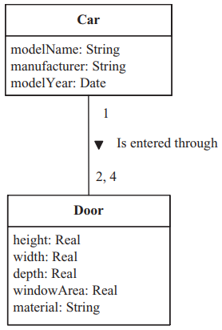
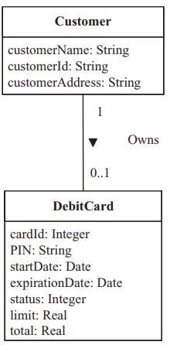
Association Between Classes UML Notations 1/2
Notes:
Persistent: cố hữu, kiên trì

Slide 9
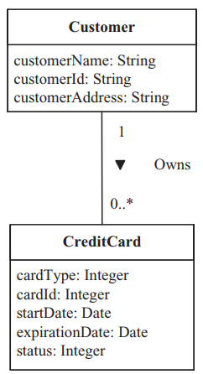
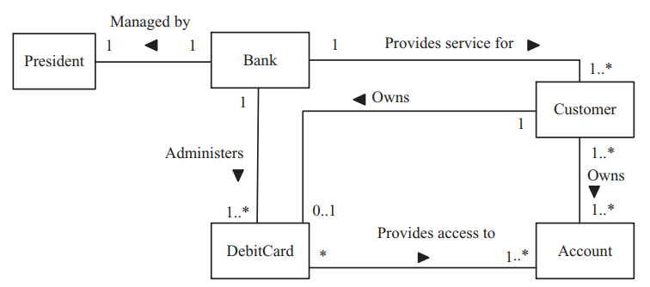
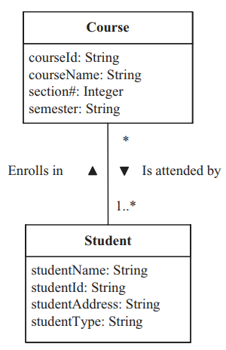
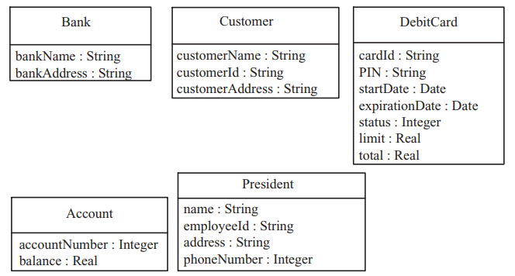
Association Between Classes UML Notations 2/2
﻿Associations on a class diagram
Class attributes
Notes:
Persistent: cố hữu, kiên trì

Slide 10
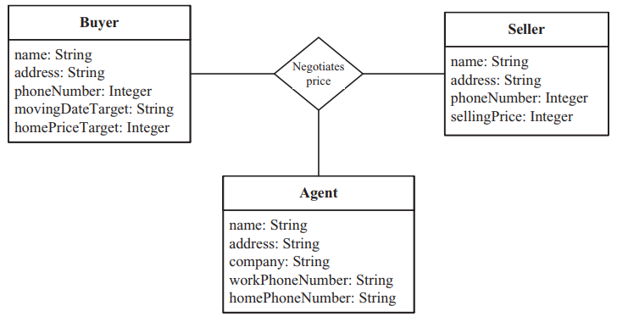
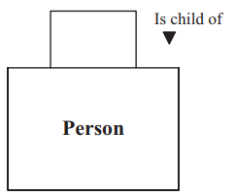
Association Between Classes Ternary & Unary Associations
﻿A ternary association is a three-way association among classes.
﻿A unary association, also referred to as a self-association, is an association between an object of one class and another object in the same class.
Person ﻿Is child of Person
﻿Person Is married to Person
Employee Is boss of Employee
The Buyer negotiates a price with the Seller through an Agent
Notes:
Ternary: bậc ba
Unary: một ngôi

Slide 11
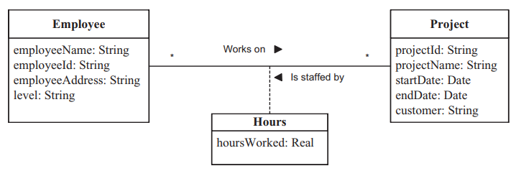
Association Between Classes ﻿Association Classes
﻿An association class is a class that models an association between two or more classes.
The attributes of the association class are the attributes of the association.
In a complex association between two or more classes, it is possible for an association to have attributes. This happens most often in many-to-many associations, where an attribute does not belong to any of the classes but belongs to the association.
Association Class Example﻿
Project Is staffed by Employee; Employee Works on Project

Slide 12
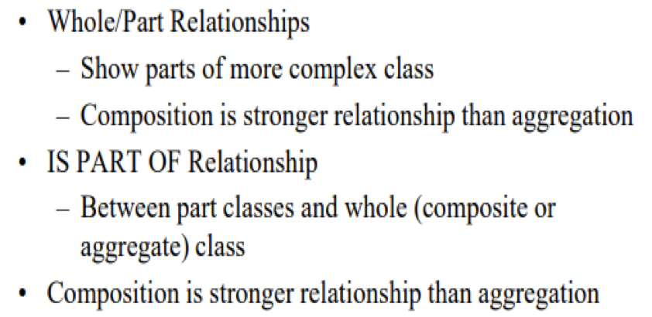
Composition & Aggregation Hierarchies
﻿Composition & aggregation hierarchies address a class that is made up of other classes
﻿Special forms of a relationship in which classes are connected by the whole/part relationship
﻿ The relationship between the parts and the whole is an Is part of relationship
Relationship
Characteristics

Slide 13
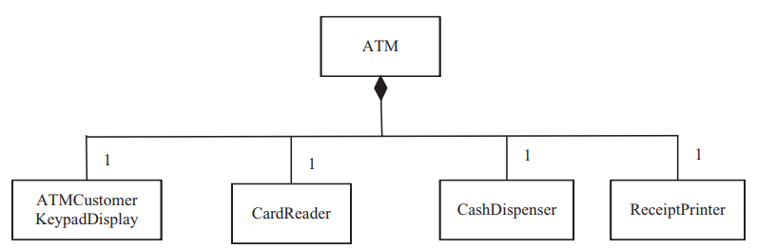
Composition & Aggregation Hierarchies Composition Relationship
﻿In composition relationship, ﻿the part objects are created, live, and die together with the whole. The part object can belong to only one whole.

Slide 14
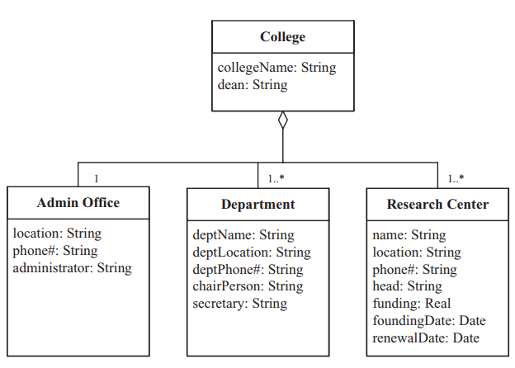
Composition & Aggregation Hierarchies Aggregation Hierarchy
﻿The aggregation hierarchy is a weaker form of whole/part relationship.
Part instances can be added to and removed from the aggregate whole. For this reason:
﻿Aggregations are likely to be used to model conceptual classes rather than physical classes.
A part could belong to more than one aggregation

Slide 15
﻿Generalization/Specialization Hierarchy
﻿Some classes are similar but not identical. They have some attributes in common and others that are different
﻿Common attributes are abstracted into a generalized class, which is referred to as a superclass
﻿The different attributes are properties of the specialized class, which is referred to as a subclass.
﻿There is an Is a relationship between the subclass and the superclass.
﻿The superclass is also referred to as a parent class or ancestor class.
The subclass is also referred to as a child class or descendent class

Slide 16
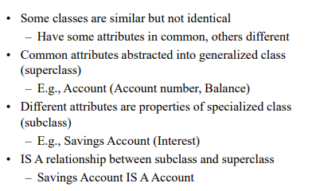
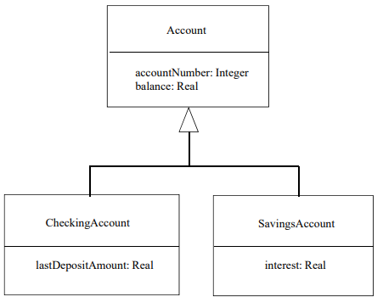
﻿﻿Generalization/Specialization Hierarchy Inheritance of Class Attributes/Operations
﻿Each subclass inherits the properties (﻿attributes, operations) of the superclass but then extends these properties in different ways

Slide 17
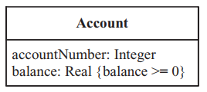
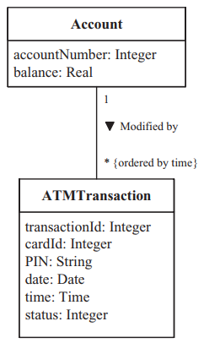
Static Modeling & The UML
﻿The approach used in COMET is to have a conceptual static model early in the analysis phase that is used to model and help understand the problem domain.
The initial emphasis is on modeling physical classes & entity classes
﻿Physical classes: classes that have physical characteristics – that is, they can be seen & touched (﻿users, external systems, timers)
﻿Entity classes are conceptual data-intensive classes that are often persistent (long-living).
A constraint specifies a condition or restriction that must be true
﻿Example of constraints on objects
﻿ ﻿Ordering in classes association: an example of constraint (restriction) on ﻿an association link
Notes:
Prevalent: thịnh hành

Slide 18
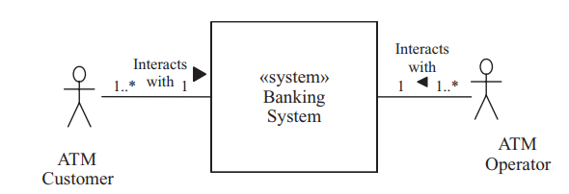
Context Modeling
﻿Context modeling explicitly identifies what is inside the system and what is outside.
Can be done at the total system (hardware and software) level or at the software system (software only) level
Helps to ﻿understand the scope of a computer system: what is to be included inside the system and what is to be left outside the system
﻿A diagram that explicitly shows the border between the system (hardware and software), which is treated as a black box, and the external environment is called a system context diagram
Notes:
Prevalent: thịnh hành

Slide 19
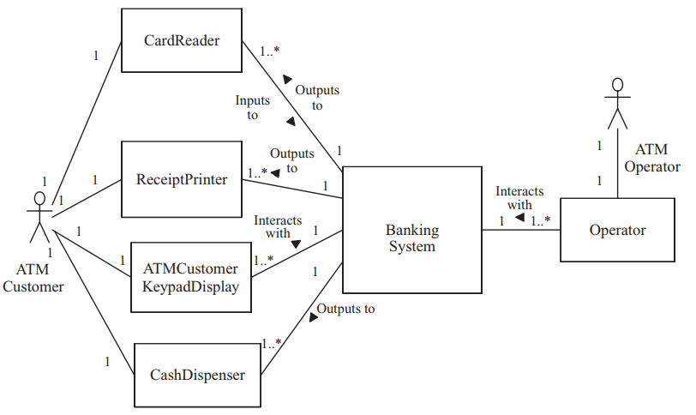
Context Modeling Software System Context Diagram
﻿A diagram that explicitly shows the border between the software system, also treated as a black box, & the external environment (which now includes the hardware)
Notes:
﻿The ATM Operator interacts with the system via a keypad and display.

Slide 20
Context Modeling Classes Categorization Using UML Stereotypes
﻿In class structuring, the COMET method advocates categorizing classes in order to group together classes with similar characteristics
﻿In UML, stereotypes are used to distinguish among the various kinds of classes
﻿A stereotype is a subclass of an existing modeling element (e.g., an application or external class) that is used to represent a usage distinction (e.g., the kind of application or external class)
﻿In the UML notation, a stereotype is enclosed by guillemets («entity»).
In software applications, a class is categorized by the role it plays in the application («entity», «boundary», «control»)
﻿External classes are categorized on the basis of their characteristics in the external environment, such as «external system» or «external user»
Notes:
﻿The ATM Operator interacts with the system via a keypad and display.

Slide 21
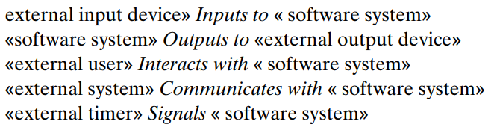
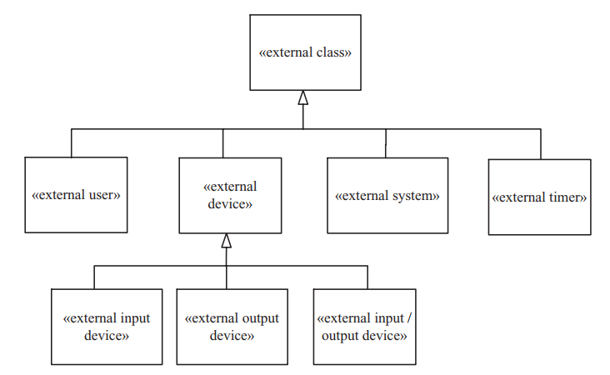
Context Modeling Modeling External Classes 1/3
﻿A human user often interacts with the software system by means of standard I/O devices such as a keyboard/display and mouse﻿
External input device: a device
that only provides input to the
system – for example, a sensor
External output device: a device that only receives output from the system – for example, an actuator
External I/O device: a device that both provides input to the system and receives output from the system – for example, an ATM card reader
Notes:
﻿The ATM Operator interacts with the system via a keypad and display.

Slide 22
Context Modeling Modeling External Classes 2/3
﻿Actors and External Classes
﻿Actors are a more abstract concept than external classes. The relationship between actors and external classes is as follows:
﻿An I/O device actor is equivalent to an external I/O device class. This means the I/O device actor interfaces to the system via an external I/O device class.
An external system actor is equivalent to an external system class.
﻿A timer actor interfaces to the system via an external timer class, which provides timer events to the system.
A human user actor has the most flexibility. In the simplest case, the user actor interfaces to the system via standard user I/O devices, such as keyboard, visual display, and mouse
Notes:
﻿The ATM Operator interacts with the system via a keypad and display.

Slide 23
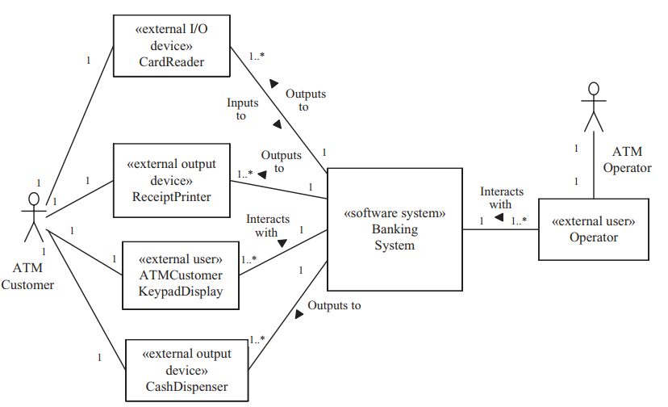
Context Modeling Modeling External Classes 3/3
﻿Banking System software context class diagram with stereotypes
Notes:
﻿The ATM Operator interacts with the system via a keypad and display.

Slide 24
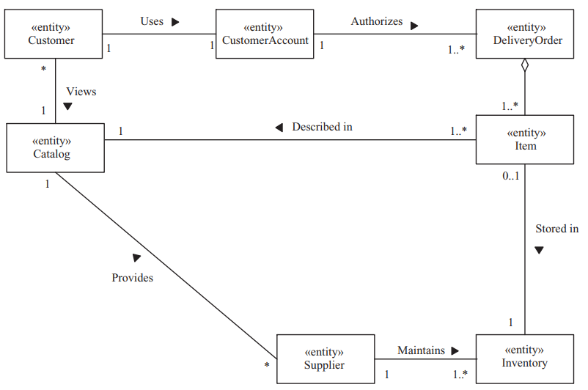
Static Modeling of Entity Classes
﻿Entity classes: store data and provide access to this data
﻿During static modeling of the problem domain, the COMET emphasis is on determining the entity classes that are defined in the problem, their attributes, and their relationships
﻿Entity class model for online shopping application

Slide 25
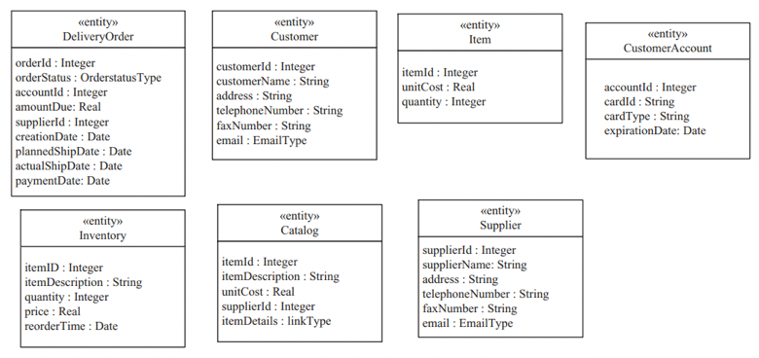
Static Modeling of Entity Classes ﻿Modeling Class Attribute
﻿Each class has several attributes that provide information that distinguishes this class from other classes. Furthermore, each instance of the class has specific values of these attributes to differentiate it from other instances of the class

Slide 26


